Slide 1
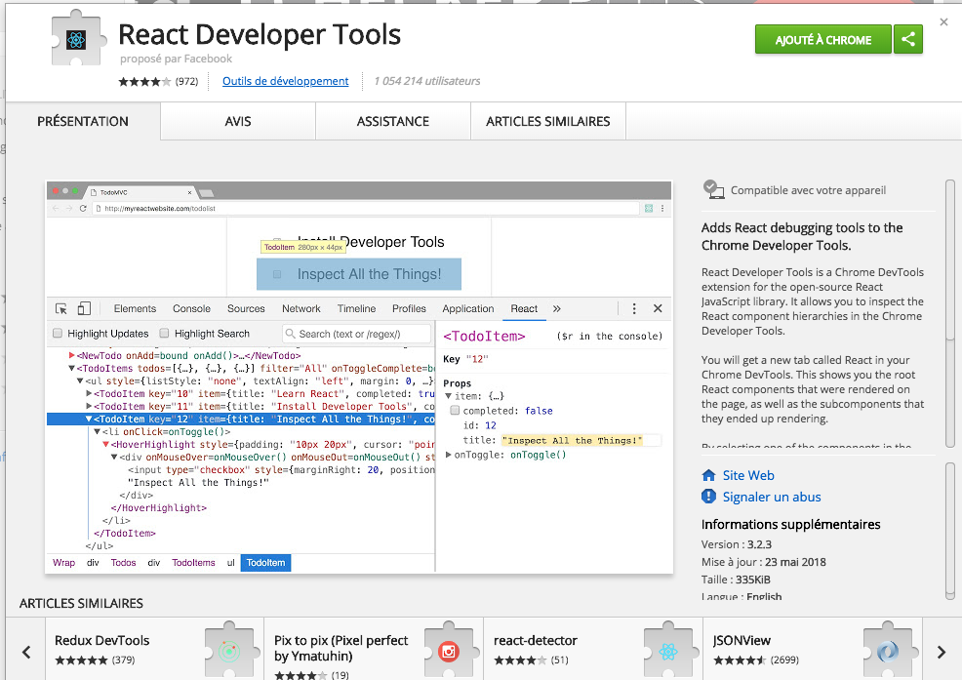
Le plugin react developer tools

